Slide 1
Mt. Olive Pickles a rebranding project
Linda Cline

Slide 2
Company Profile

Slide 3
Corporate Philosophy
“Our business decisions continue to be guided by basic tenets that have served our Company well over the years:
Provide customers with quality products, good value, and superior service
Earn shareholders a fair return on investment
Be a progressive employer
Remain a valued corporate citizen¹”
1 http://www.mtolivepickles.com/about-us/

Slide 4
Retail Sales
#1
2nd
brand in the Southeast
best-selling brand in the US
Share of pickle sales up to
Distribution in
44
70%
States

Slide 5
Current Logo

Slide 6
Logo Critique
Good
Needs Improvement
Brand is well known and recognized by the logo used
Curves give the design nice movement
Simple shapes leave the design uncluttered
A more playful font would make the brand friendlier
Choose a more appetizing color palette
Branches could be better integrated with design

Slide 7
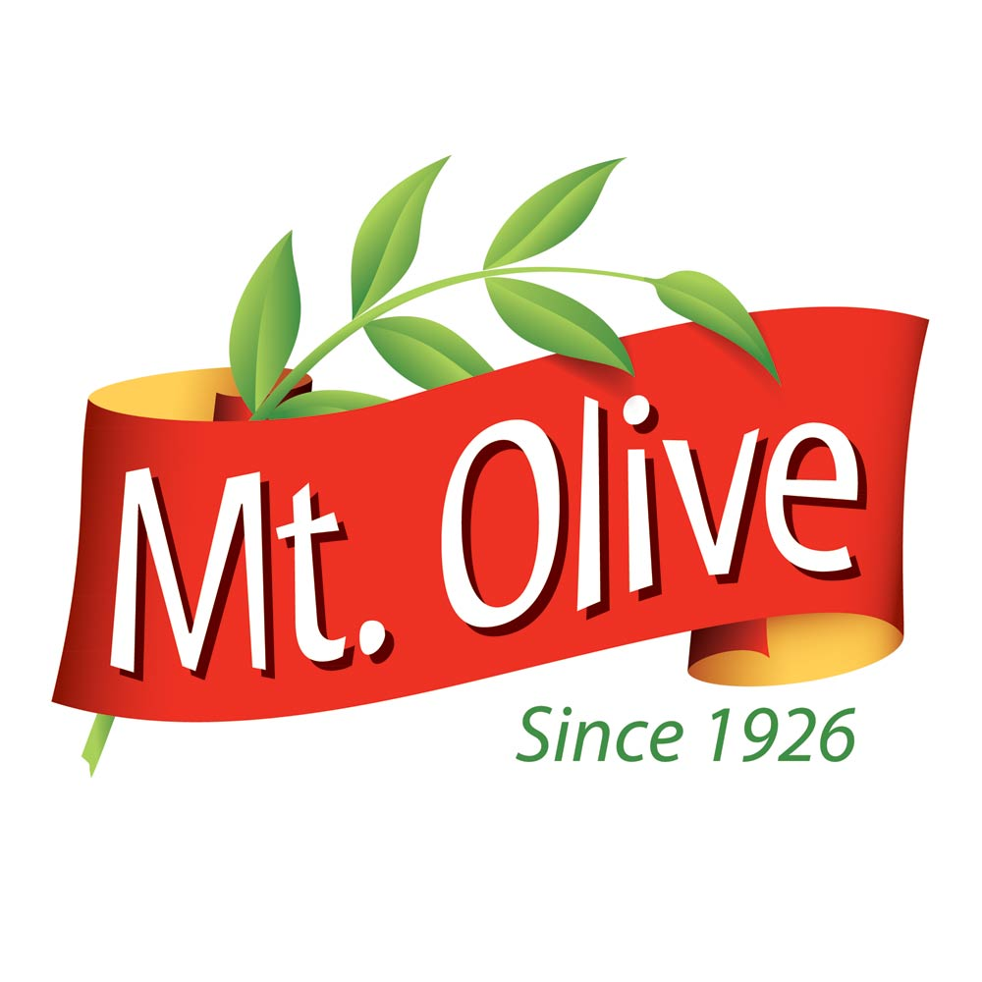
New Logo Development

Slide 8
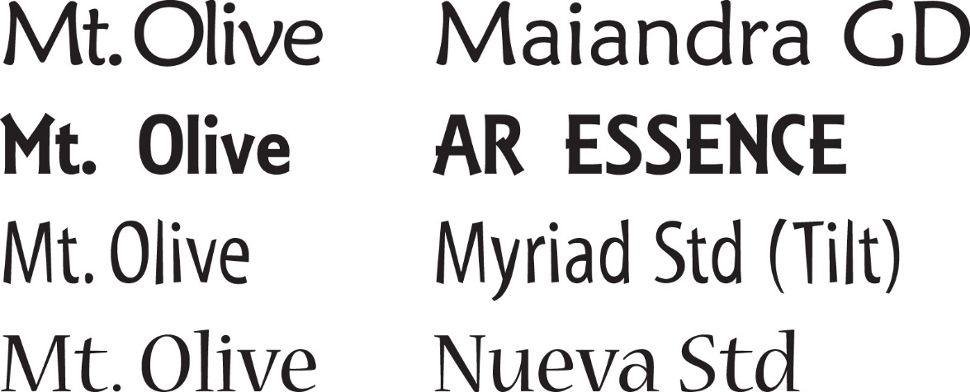
Design Concept
^{The look:} playful without being overly childish
^{Colors:} Bright, eye-catching, appetizing colors
^{Fonts: Sans serif with playful} ^{style or stroke variation,} small-serifed font, or possibly hand lettering
^{Possible fonts:}

Slide 9
Thumbnail Sketches

Slide 10
Final Vector Image

Slide 11
Logo Usage

Slide 12
Corporate Identity Package

Slide 13
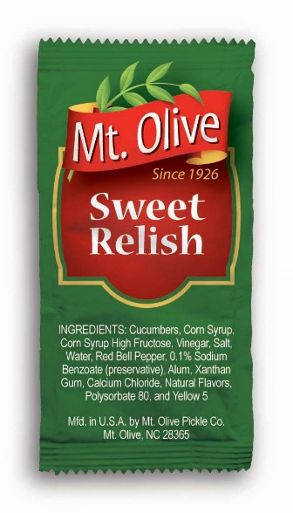
Product Labels

Slide 14
Outdoor Graphics

Slide 15
Designed by Linda Cline
Visit my online portfolio
lindacline.weebly.com

